Slide 1

Helix Medical Devices Presentation
Presented by
David Watson | Daniel Chiriaev | Yun Hostetter | Group 1
[CIS56] | Database Management Systems II
Oracle SQL Developer 4.1.4.21
Oracle Database 11g EE 11.2.0.1.0
SQL * PLUS 12.2.0.1.0
Professor Ahmed Ezzat
12-14-2020

Slide 2
Agenda
Introduction
Our Team
Helix Medical Devices
Problem Definition
Database Management Solutions
Our Approach, Design & Implementation
Entity Relationship Diagram
Stored Procedures
AES192 Encryption
Entity Tables | Primary & Foreign Key List
Demo Overview
Demo Package Components
Conclusion

Slide 3
Introduction
Web-based business owned and operated in San Jose, California
Headquartered in San Jose, California
Specialize in medical device sales via an online E-commerce solution
Primary product focus:
COVID-19 Test Kits
Hospital Bed Linens
Adjustable Hospital Beds
Hydrotherapy Fitness Equipment
Glucose Monitoring Systems
Wound Dressing Kits
Primary demographics and target audience include:
Small, mid-market, large, and strategic organizations

Slide 4

David Watson
Account Manager
Experienced Account Manager with 20+ years of sales & marketing experience
Actively manage 250+ small, mid-market, large & strategic accounts
Responsible for prospecting new business and exceeding sales quotas

Slide 5
Daniel Chiriaev
DBA/Product Manager
Planning, development, performance, troubleshooting, security of DB
Coordinating all activities required to bring product to launch
Gathering and prioritizing all product requirements

Slide 6
Yun Hostetter
Project Manager
Planning, development, performance, troubleshooting, security of DB
Coordinating all activities required to bring product to launch
Gathering and prioritizing all product requirements

Slide 7
About Helix Medical Devices
Helix Medical Devices was founded in 2001 with a belief system that every client should be able to effectively and strategically purchase medical device equipment via an E-commerce solution. We set out to create a platform that would be user-friendly and include a real-time inventory management system that would be easy to use. Over the years, as technology and graphical capabilities have advanced, our product line and website have evolved and expanded in parallel, allowing us to introduce and implement new features and updates annually.

Slide 8
Limited Database Management Options
One of the issues within the data management industry is that a lot of companies don’t invest in database management software that offers extensive reporting options and capabilities to their clients. The software is capable of managing data for the company, but therein lies the limitation.

Slide 9
Database Management Solution
Here at Helix Medical Devices, we understand that our customers need access to their activities within our E-commerce suite, and their business decisions rely on this information. This is why we designed our database to not only meet our data-reporting needs, but those of our customers as well. We offer the same data-reporting options to our customers that we use. They can pull data from 21 tables and view their quote, order, invoice, shipping, and payment history via reporting options that are built into our E-commerce business suite.

Slide 10
Database Design & Implementation
Here at Helix Medical Devices, we designed our E-commerce suite and database to meet two critical needs by creating a needs-assessment model. Within this model, we handpicked server hardware that would provide sufficient data storage for at least 5 years. We then doubled that number so that we could provide the same data to our clients. As part of our design and implementation, we added a backup system that would give us peace of mind knowing that all of our data was secure and readily available.

Slide 11
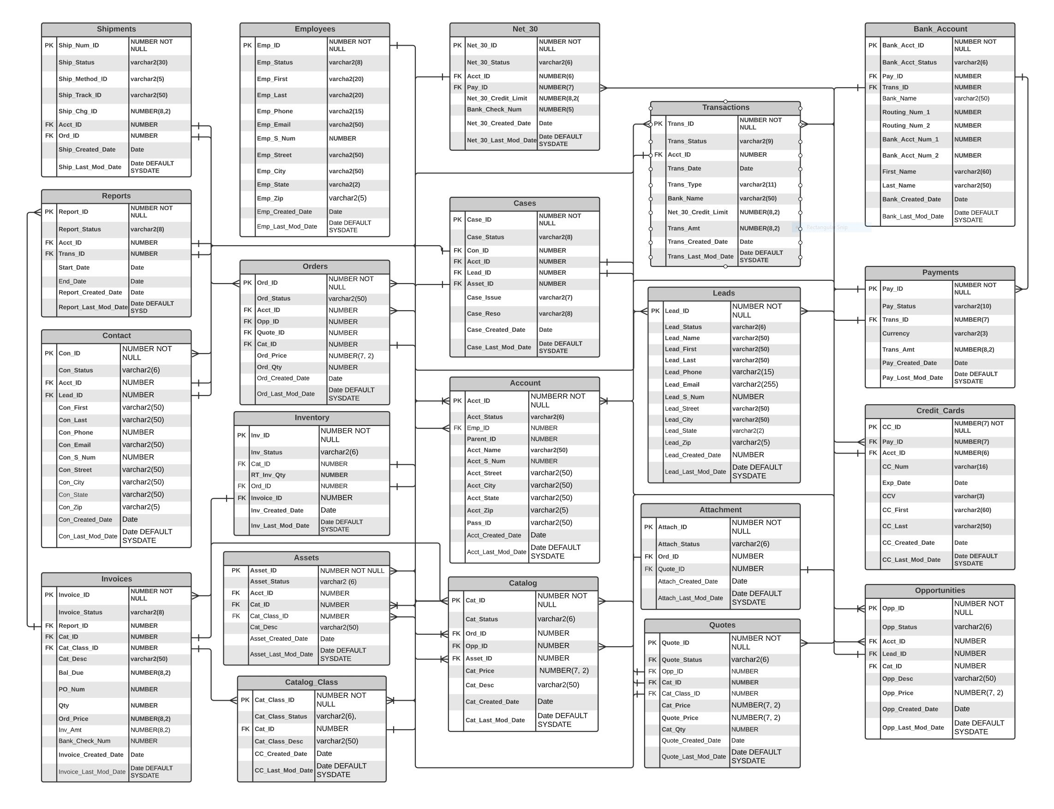
Entity Relationship Diagram

Slide 12
Stored Procedures
Product Inquiry
Generate a Proposal
View Net 30 Available Credit
Place an Order
Generate an Invoice Number
View Transaction Record
Review Payment History
View Net 30 Status
Track a Package
Review Invoice Records
Quotes Converted to Orders History
DBMS_SCHEDULER

Slide 13
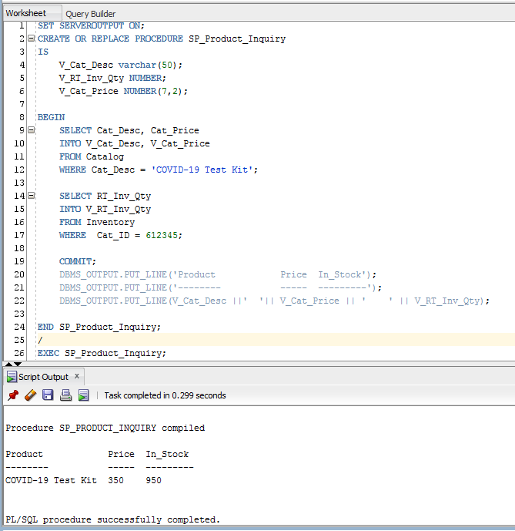
Stored Procedure I: Product Inquiry

Slide 14
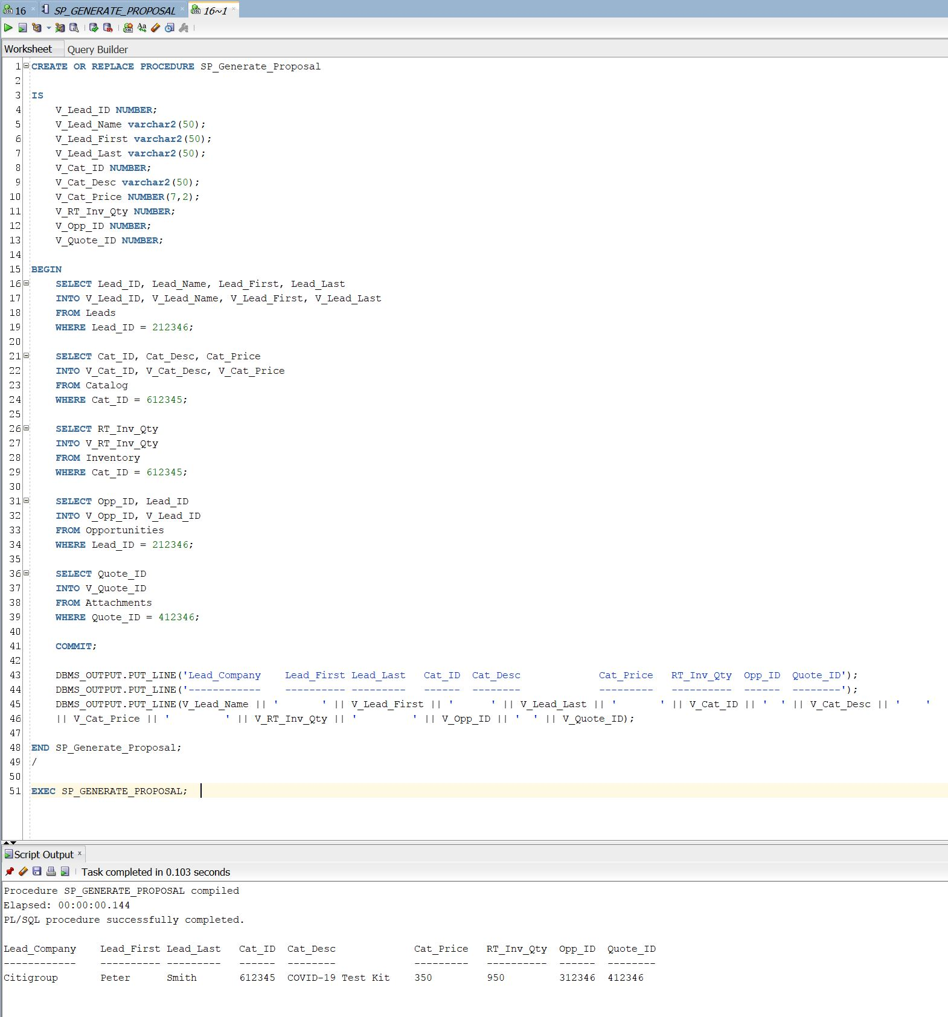
Stored Procedure II: Generate a Proposal

Slide 15
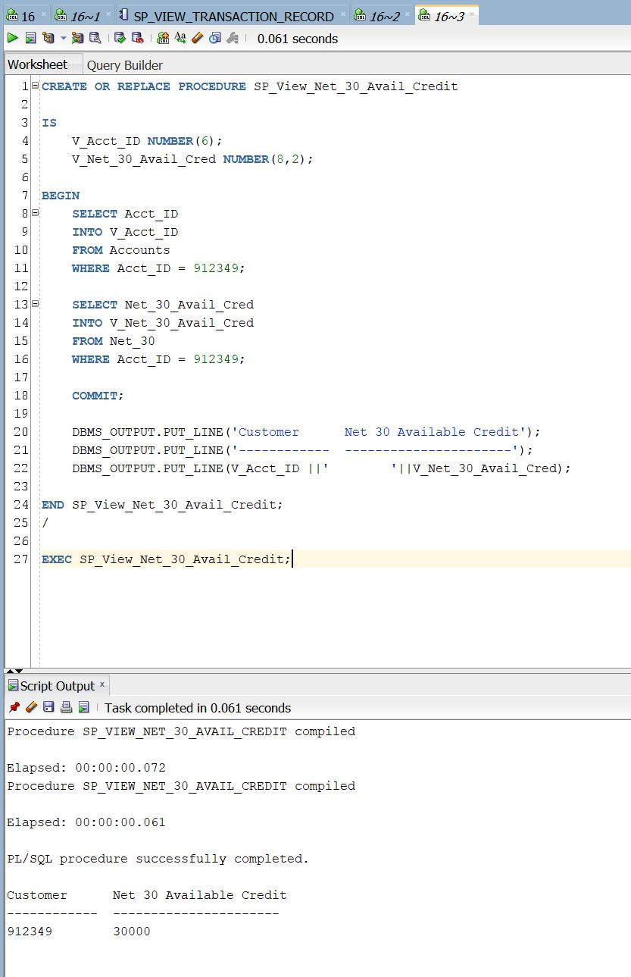
Stored Procedure III: View Net 30 Available Credit

Slide 16
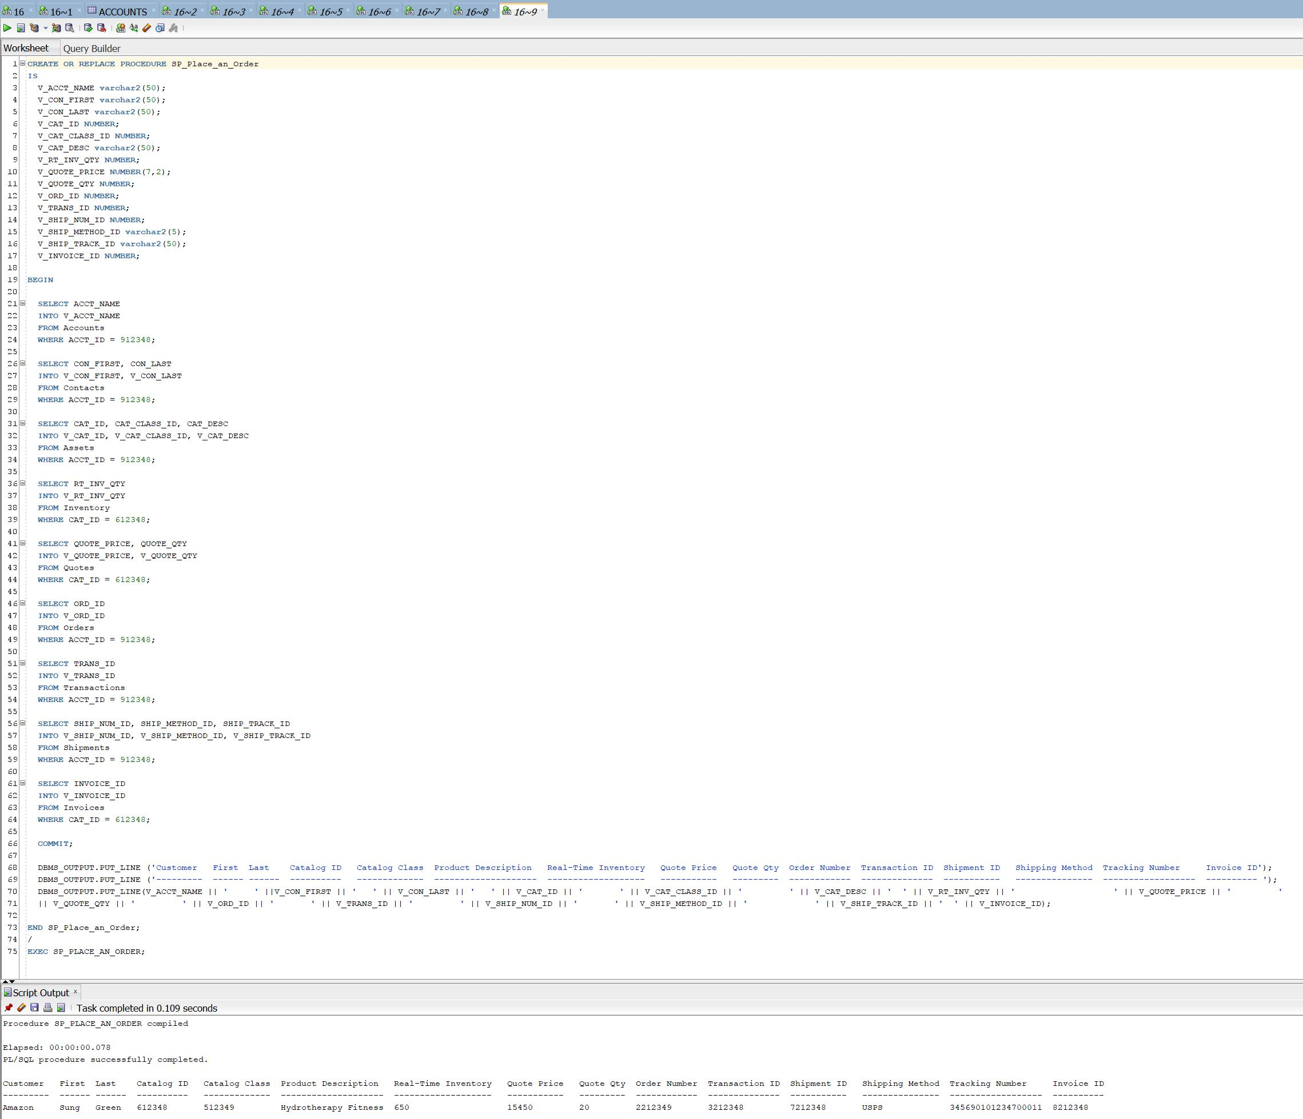
Stored Procedure IV: Place an Order

Slide 17
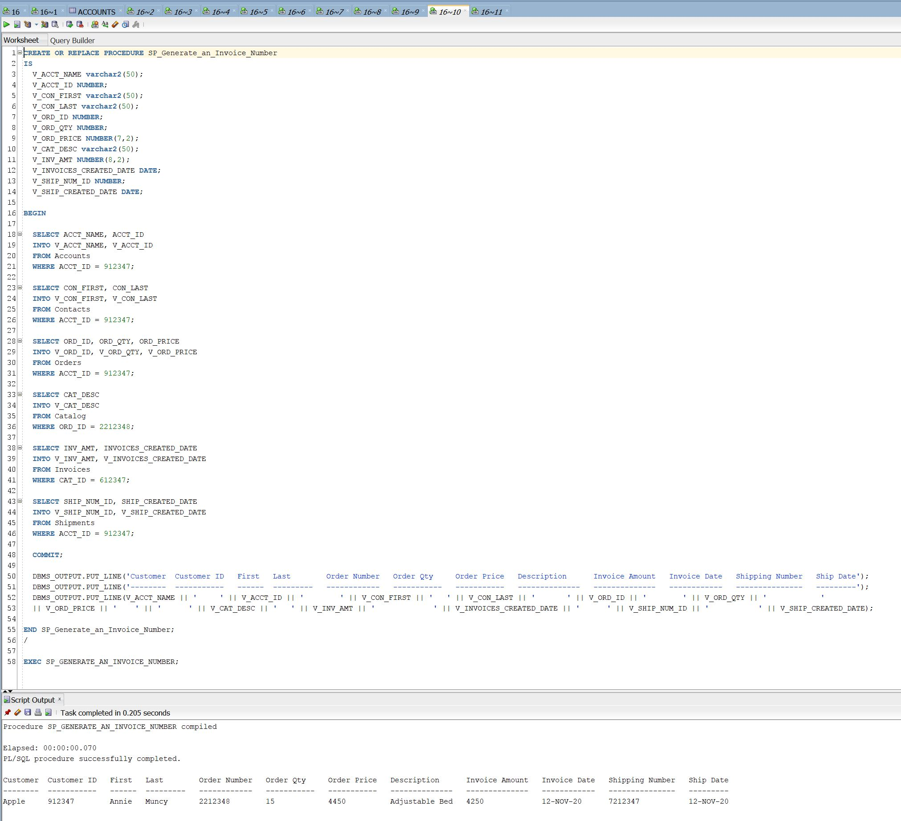
Stored Procedure V: Generate an Invoice Number

Slide 18
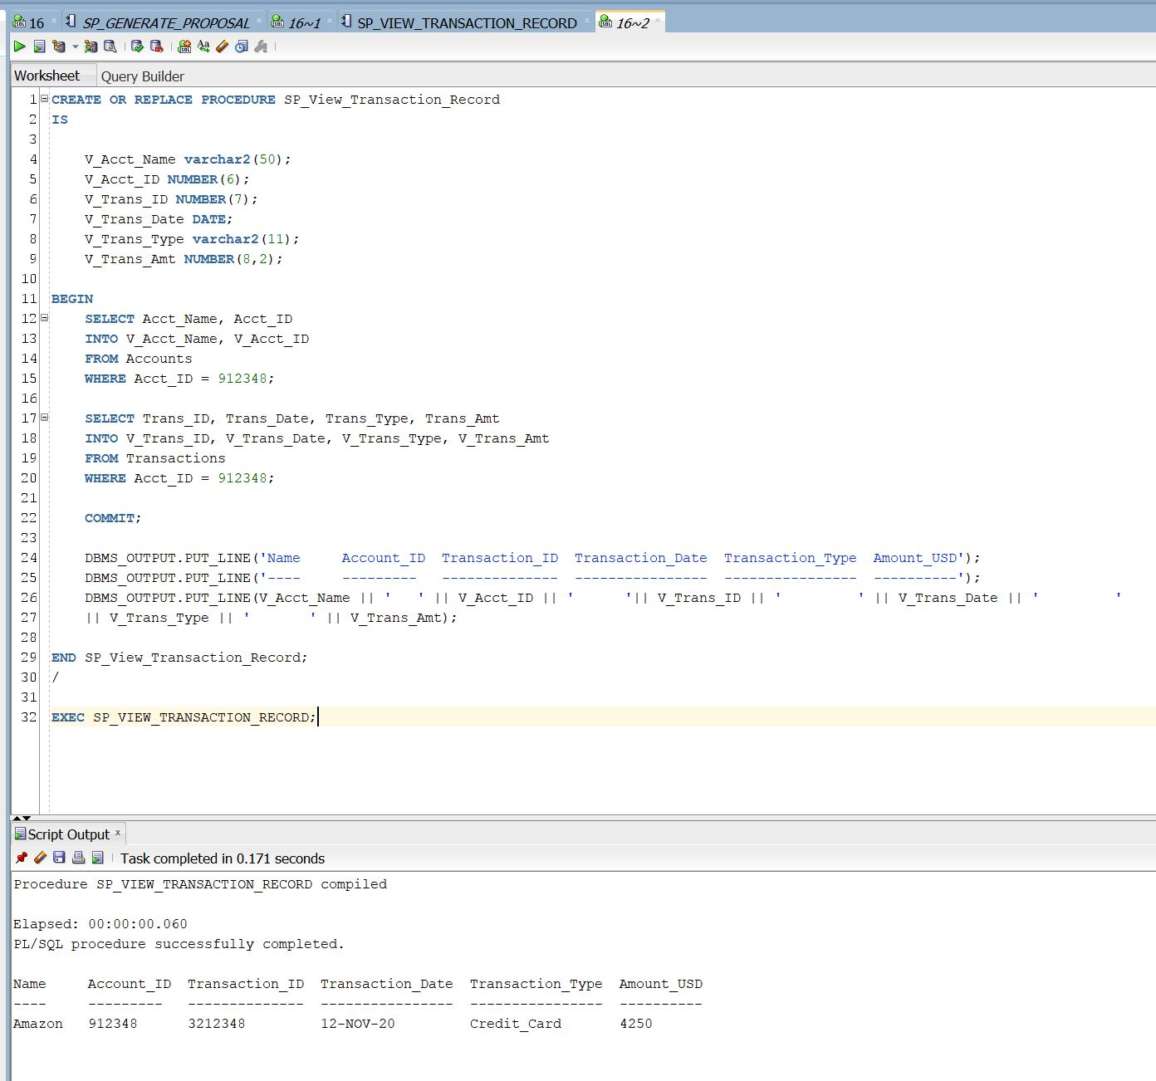
Stored Procedure VI: View Transaction Record

Slide 19
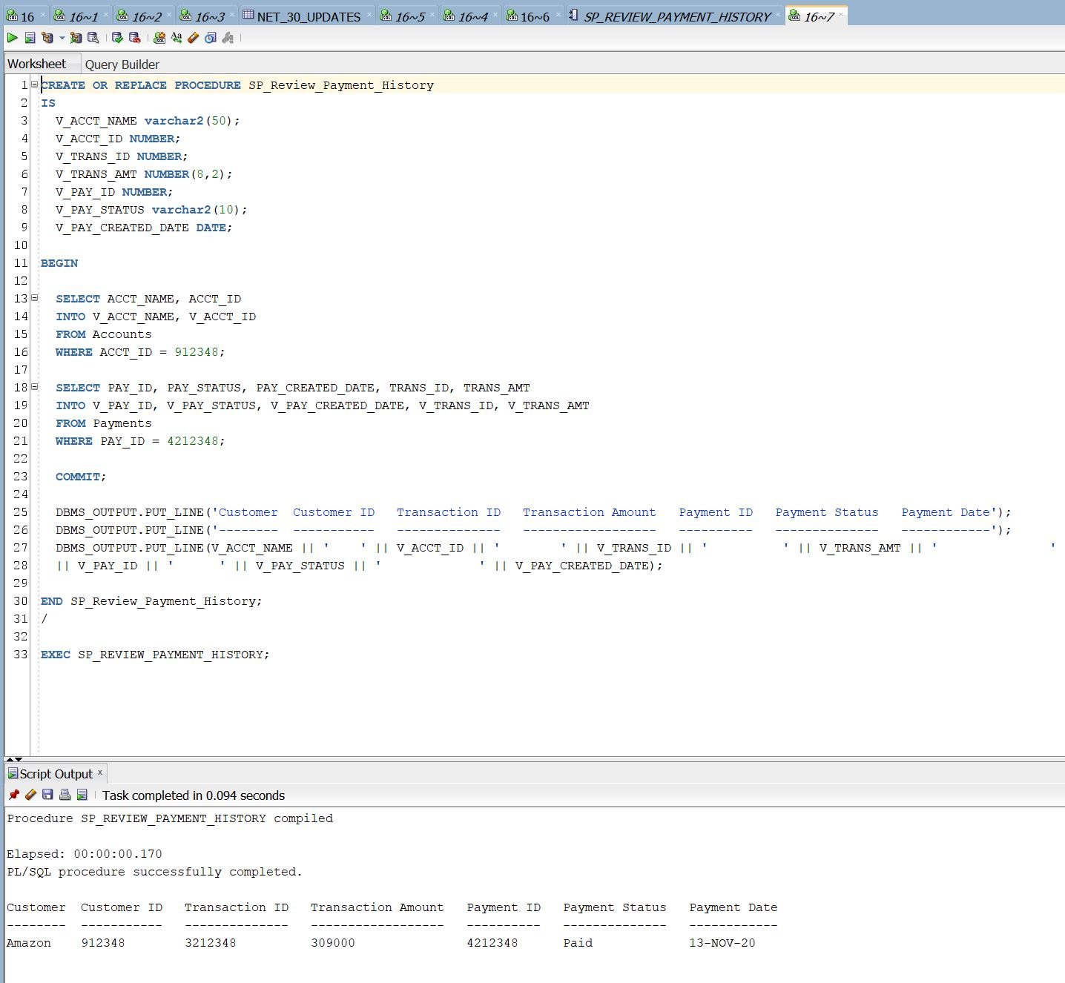
Stored Procedure VII: Review Payment History

Slide 20
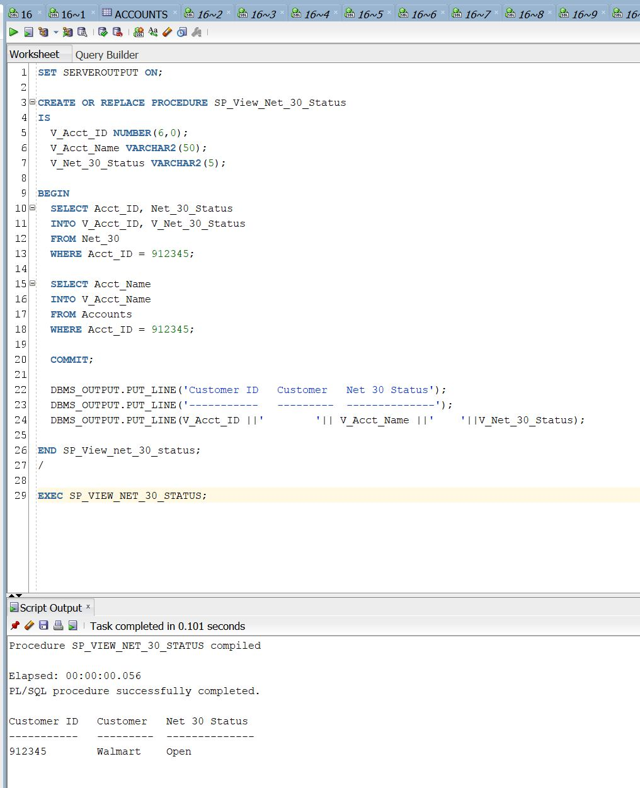
Stored Procedure VIII: View Net 30 Status

Slide 21
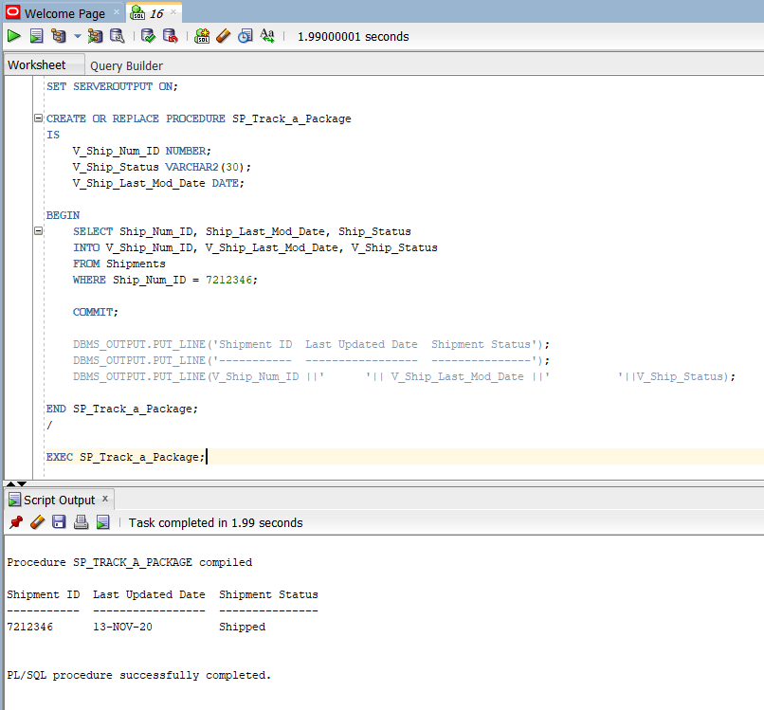
Stored Procedure IX: Track a Package

Slide 22
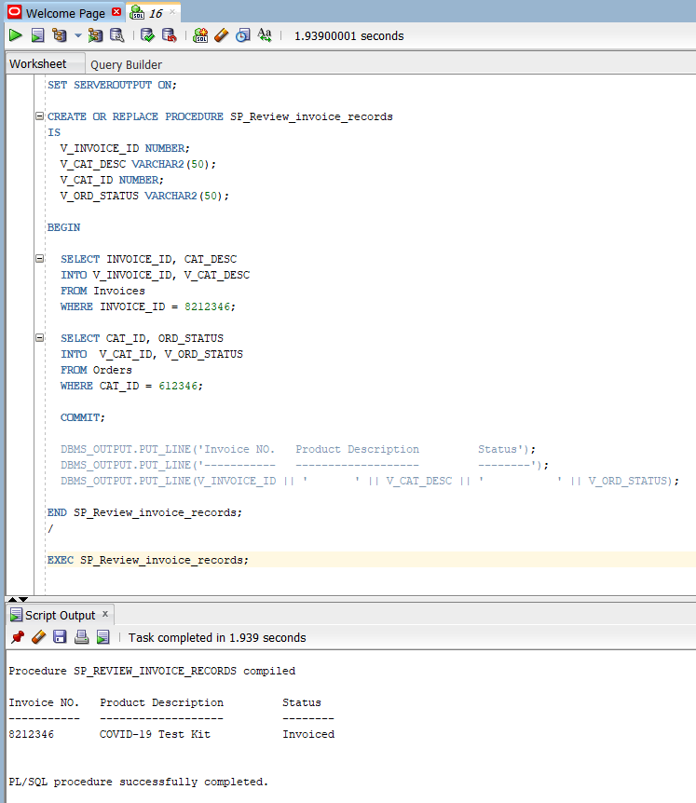
Stored Procedure X: Review Invoice Records

Slide 23
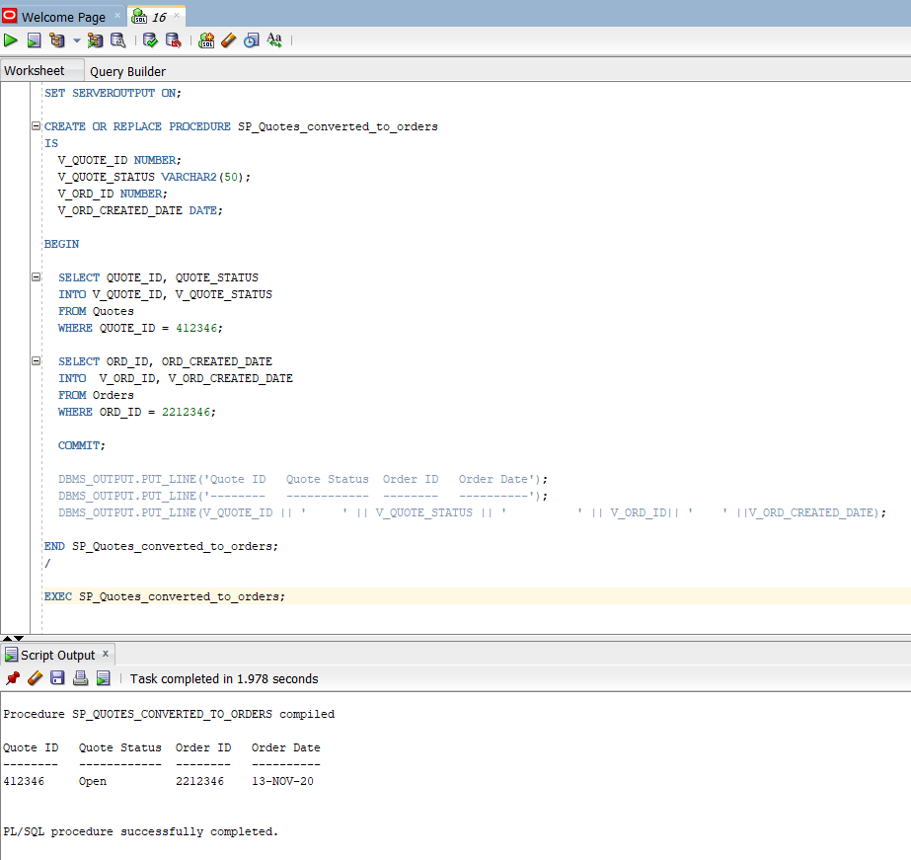
Stored Procedure XI: Quotes Converted to Orders History

Slide 24
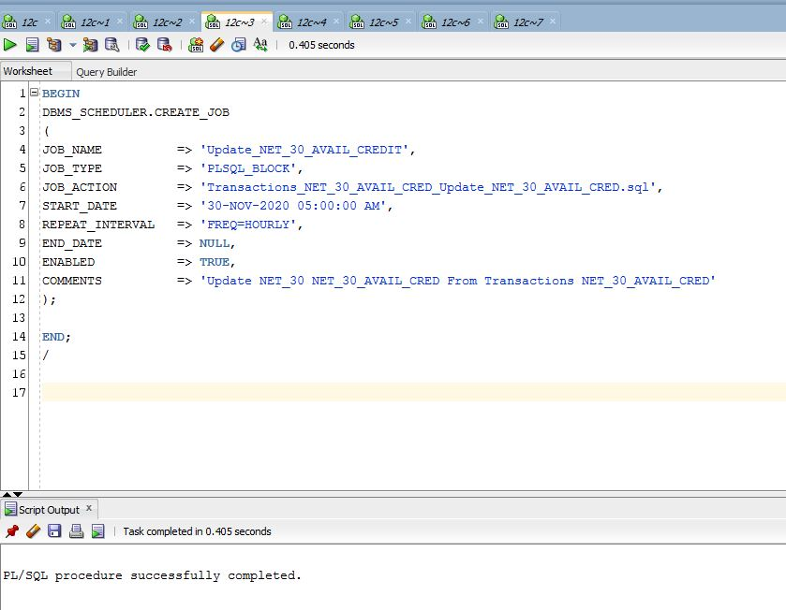
Stored Procedure XII: DBMS_SCHEDULER I

Slide 25
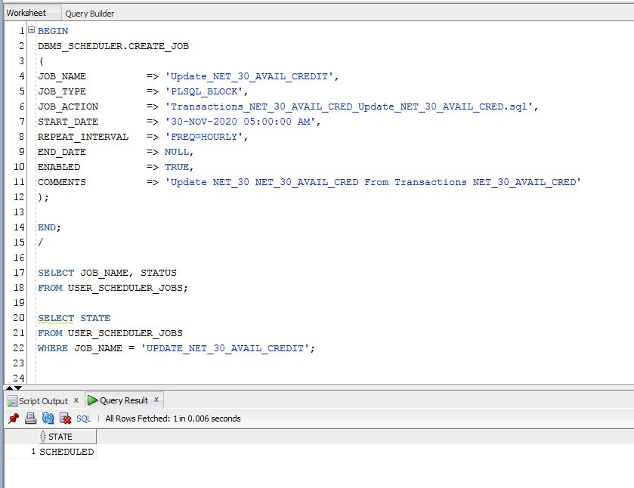
Stored Procedure XII: DBMS_SCHEDULER II

Slide 26
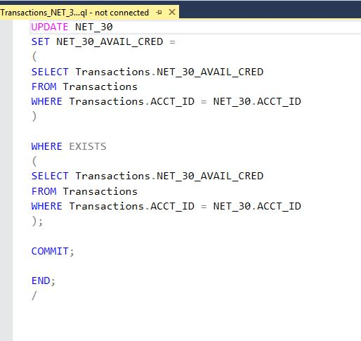
Stored Procedure XII: DBMS_SCHEDULER | Update Script

Slide 27
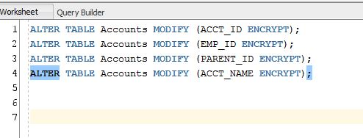
Sensitive Data Encryption | Accounts: AES192 (192-Bit)

Slide 28
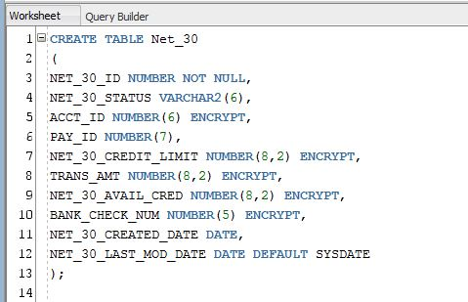
Sensitive Data Encryption | Net_30: AES192 (192-Bit)

Slide 29
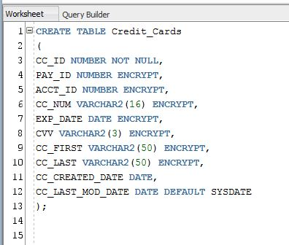
Sensitive Data Encryption | Credit_Cards: AES192 (192-Bit)

Slide 30
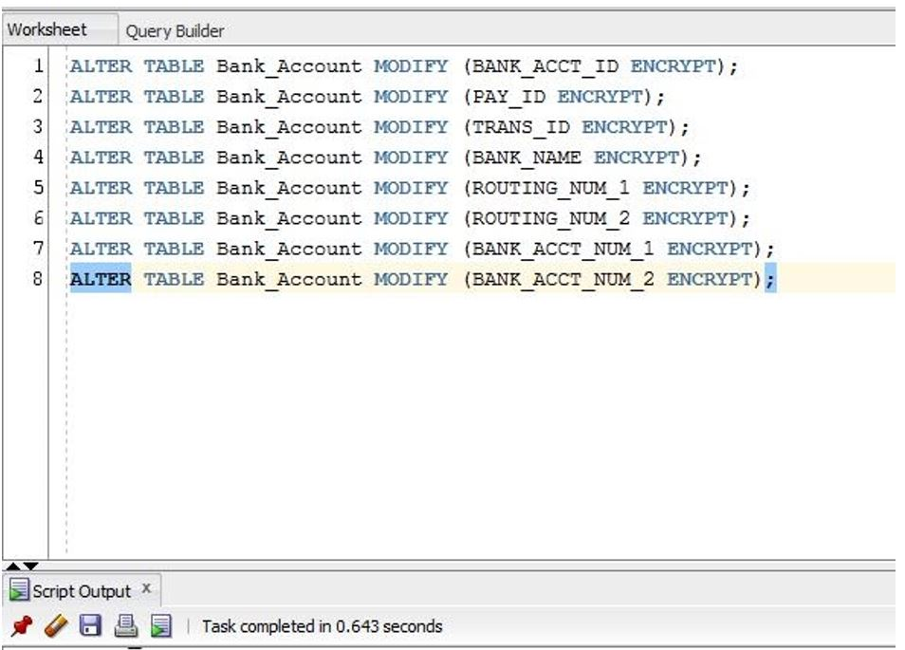
Sensitive Data Encryption | Bank_Account: AES192 (192-Bit)

Slide 31
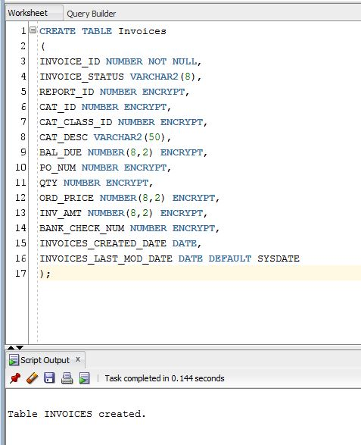
Sensitive Data Encryption | Invoices: AES192 (192-Bit)

Slide 32
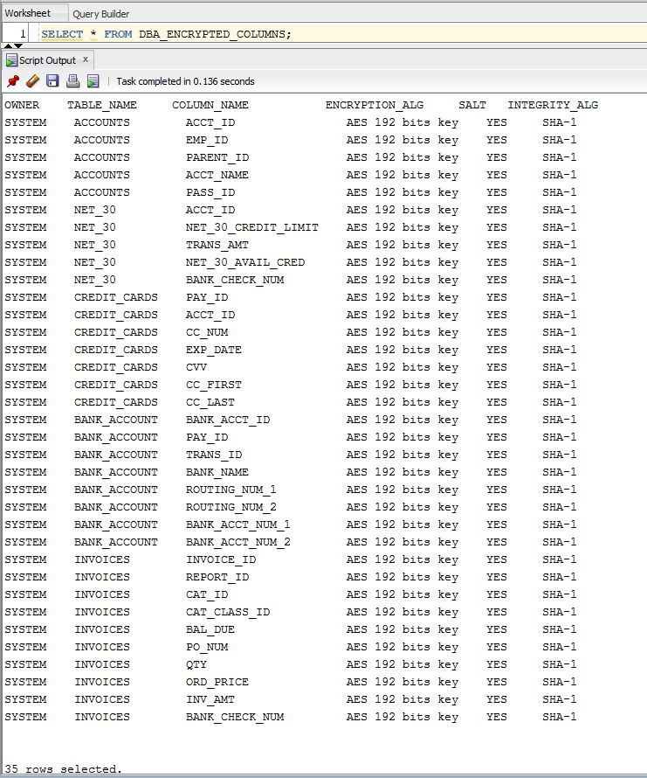
Sensitive Data Encryption | All Columns: AES192 (192-Bit)

Slide 33
Entity Tables List
Leads 12. Transactions
Catalog 13. Payments
Catalog_Class 14. Net_30
Inventory 15. Credit_Cards
Opportunities 16. Bank_Account
Quotes 17. Shipments
Attachments 18. Invoices
Accounts 19. Cases
Contacts 20. Employees
Assets 21. Reports
Orders 22. Net_30_Updates

Slide 34
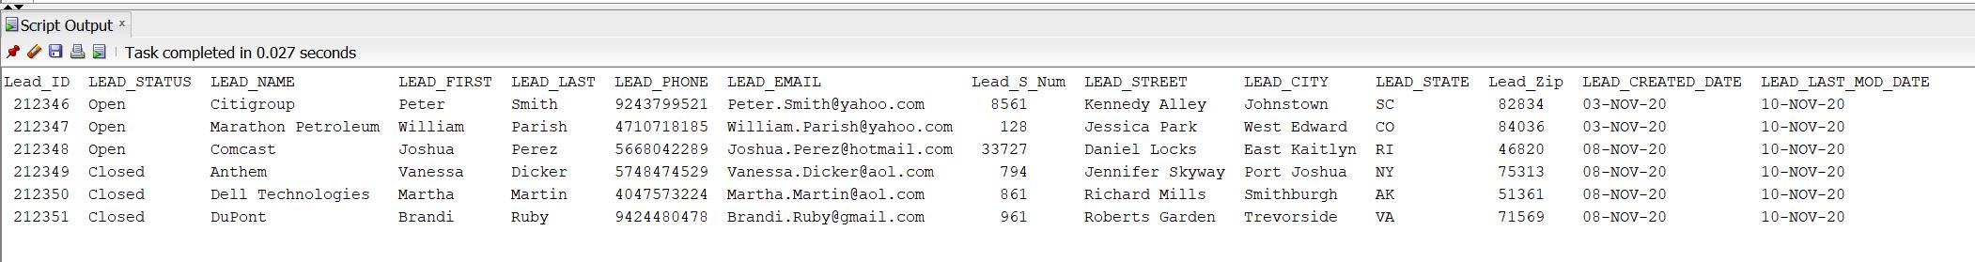
Leads
PK FKs
------------ -------
LEAD_ID N/A

Slide 35
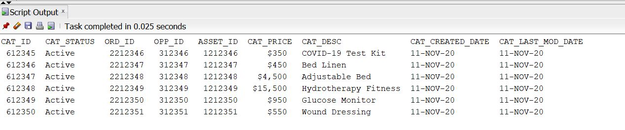
Catalog
PK FKs
------------ ------------
CAT_ID ORD_ID
OPP_ID
ASSET_ID

Slide 36
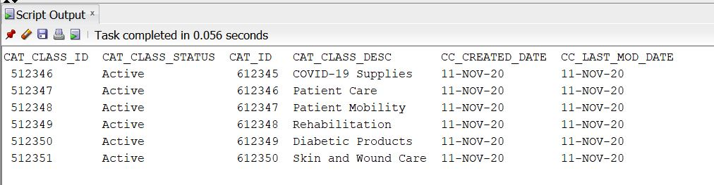
Catalog_Class
PK FKs
------------ --------- ------------
CAT_CLASS_ID CAT_ID

Slide 37
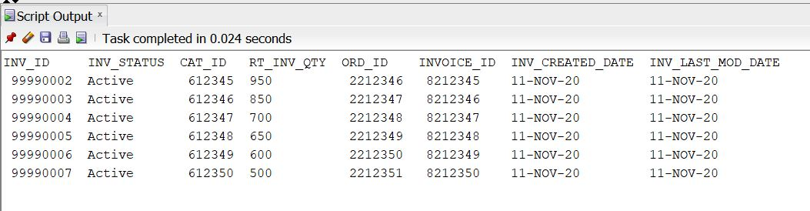
Inventory
PK FKs
------------ ------------
INV_ID CAT_ID
ORD_ID
INVOICE_ID

Slide 38
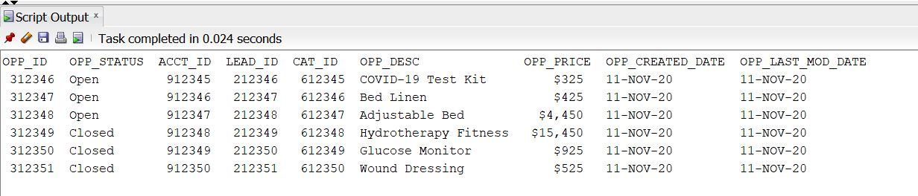
Opportunities
PK FKs
------------ ------------
OPP_ID ACCT_ID
LEAD_ID
CAT_ID

Slide 39
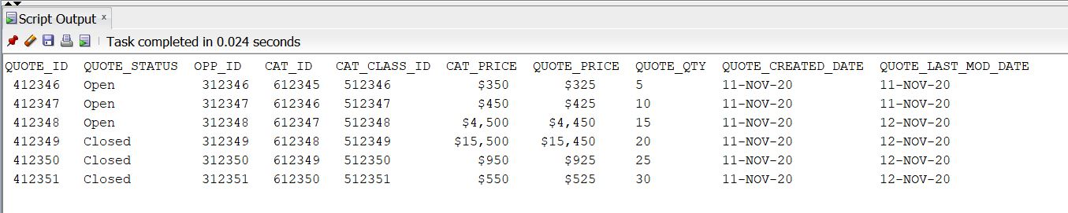
Quotes
PK FKs
------------ ------------
QUOTE_ID OPP_ID
CAT_ID
CAT_CLASS_ID

Slide 40
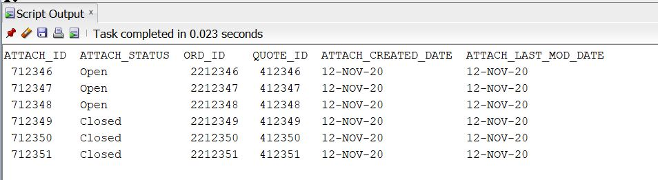
Attachments
PK FKs
------------ ------------
ATTACH_ID ORD_ID
QUOTE_ID

Slide 41
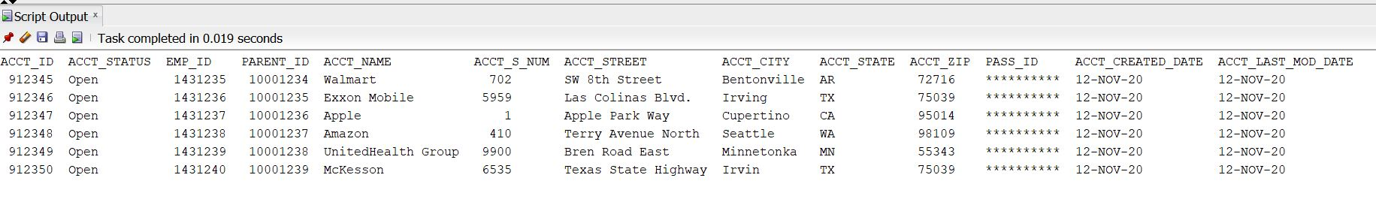
Accounts
PK FKs
------------ ------------
ACCT_ID EMP_ID

Slide 42
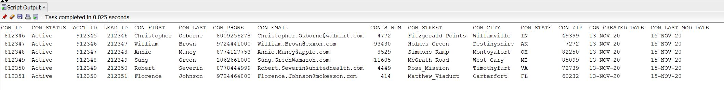
Contacts
PK FKs
------------ ------------
CON_ID ACCT_ID
LEAD_ID

Slide 43
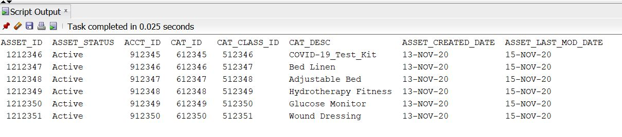
Assets
PK FKs
------------ ------------
ASSET_ID ACCT_ID
CAT_ID
CAT_CLASS_ID

Slide 44
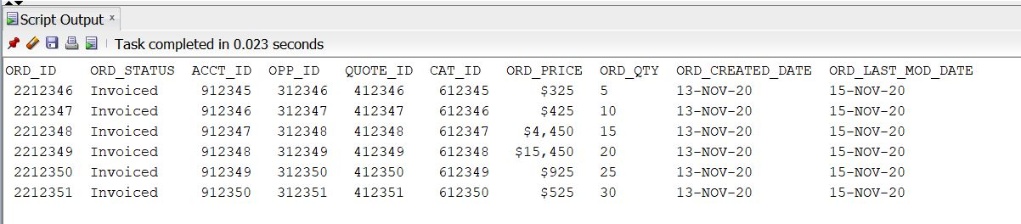
Orders
PK FKs
------------ ------------
ORD_ID ACCT_ID
OPP_ID
QUOTE_ID
CAT_ID

Slide 45
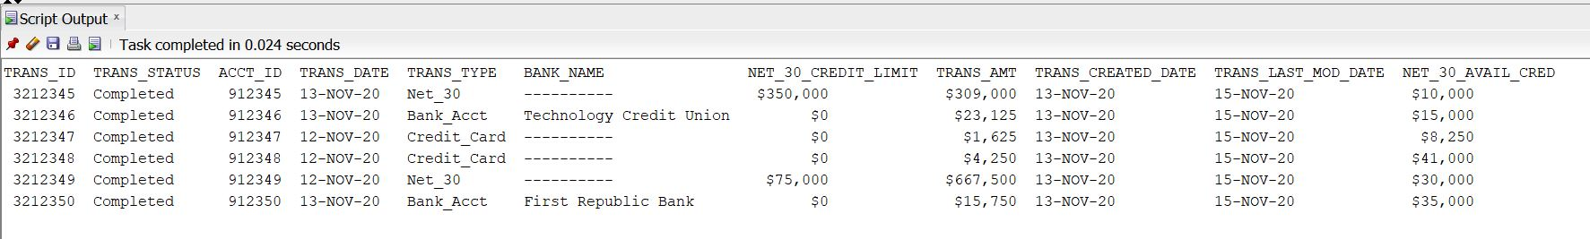
Transactions
PK FKs
------------ ------------
TRANS_ID ACCT_ID

Slide 46
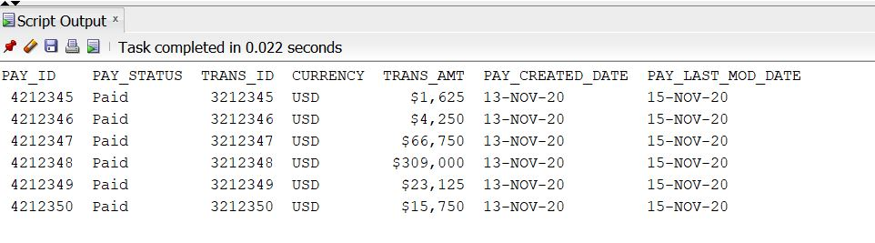
Payments
PK FKs
------------ ------------
PAY_ID TRANS_ID

Slide 47
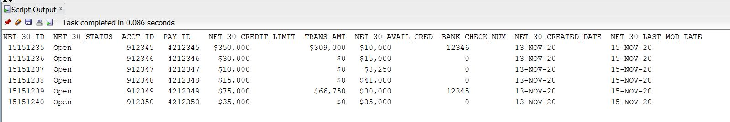
Net_30
PK FKs
------------ --- ------------
NET_30_ID ACCT_ID
PAY_ID

Slide 48
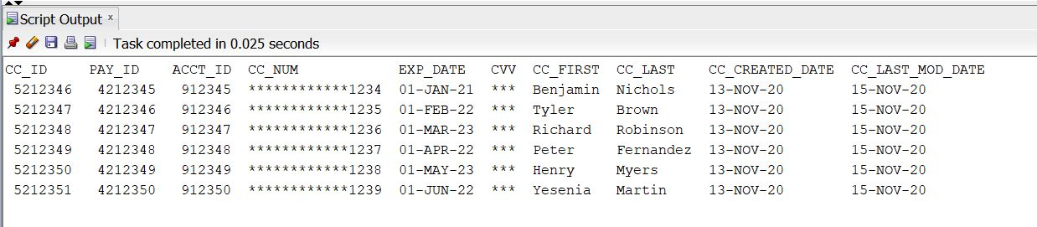
Credit_Cards
PK FKs
------------ ------------
CC_ID PAY_ID
ACCT_ID

Slide 49
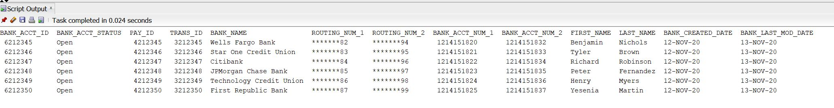
Bank_Account
PK FKs
------------ ------------
BANK_ACCT_ID PAY_ID
TRANS_ID

Slide 50
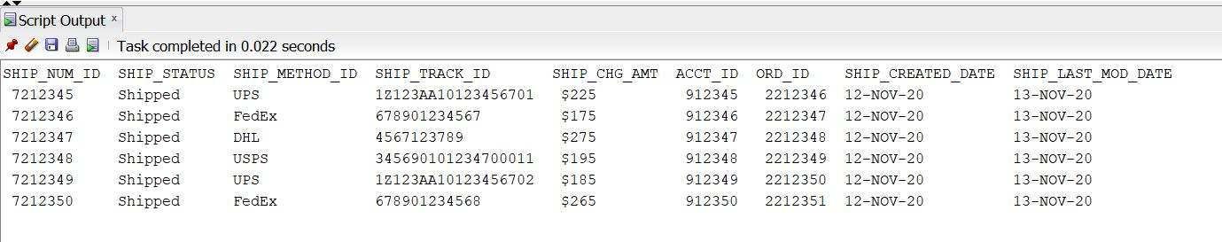
Shipments
PK FKs
------------ ------------
SHIP_NUM_ID ACCT_ID
ORD_ID

Slide 51
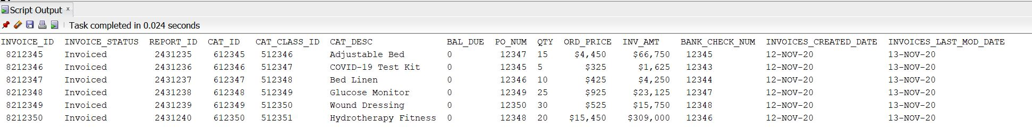
Invoices
PK FKs
------------ ------------
INVOICE_ID REPORT_ID
CAT_ID
CAT_CLASS_ID

Slide 52
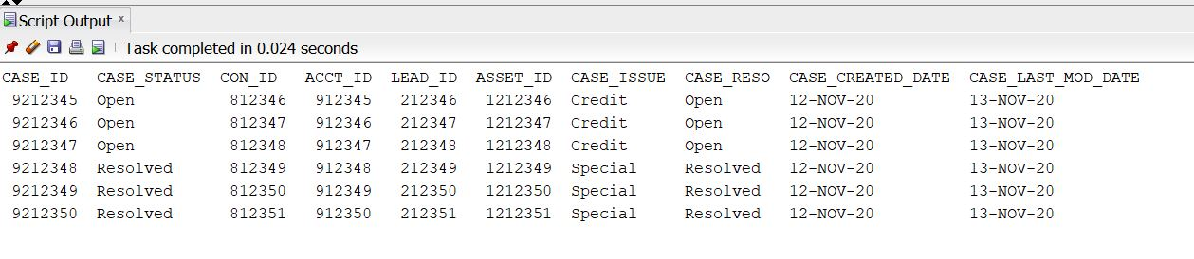
Cases
PK FKs
------------ ------------
CASE_ID CON_ID
ACCT_ID
LEAD_ID
ASSET_ID

Slide 53
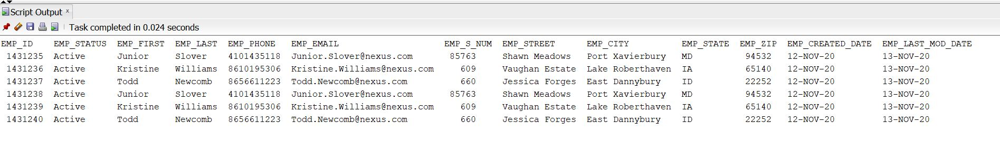
Employees
PK FKs
------------ ------------
EMP_ID N/A

Slide 54
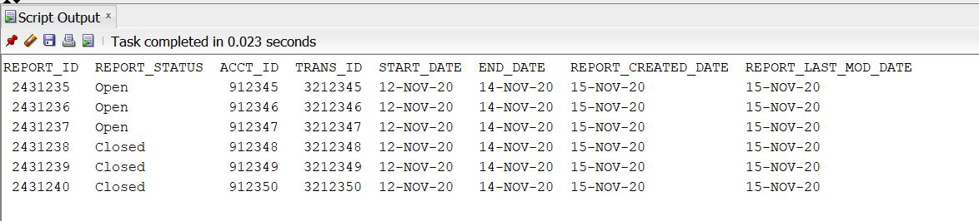
Reports
PK FKs
------------ ------------
REPORT_ID ACCT_ID
TRANS_ID

Slide 55
Demo Overview
Package Configuration
Five Components
Package Header
Function
prnt_strng
Return varchar2
Stored Procedure
2 Parameters
Package Body
Package Header Component Implementation
Function Implementation
Stored Procedure Implementation
Call Stored Procedure
Package_Name.Stored_Procedure_Name
New Table Values Inserted
Call Function
DBMS_OUTPUT.PUT_LINE
Output String
Display New Table Data
Select TO_CHAR
Insert Data Values
From Net_30_Updates
Output New Data Values

Slide 56
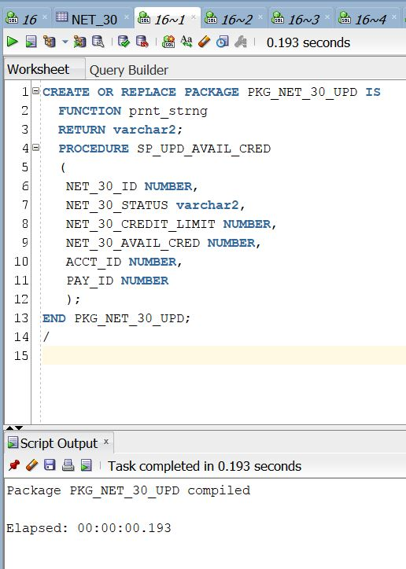
Demo: Step 1 | Package Header

Slide 57
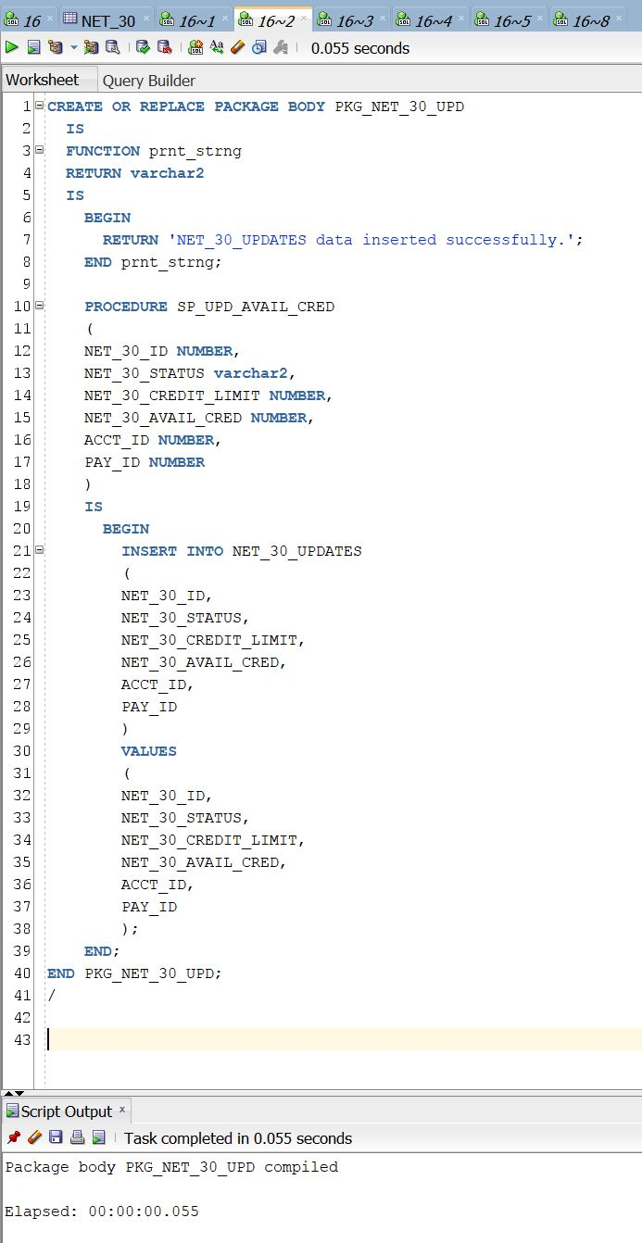
Demo: Step 2 | Package Body

Slide 58
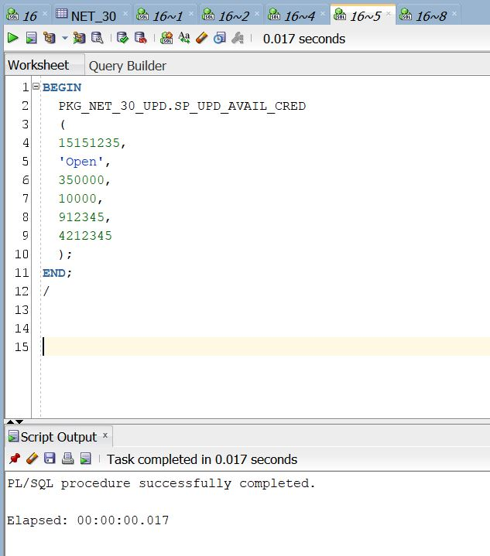
Demo: Step 3 | Assign Data Values

Slide 59
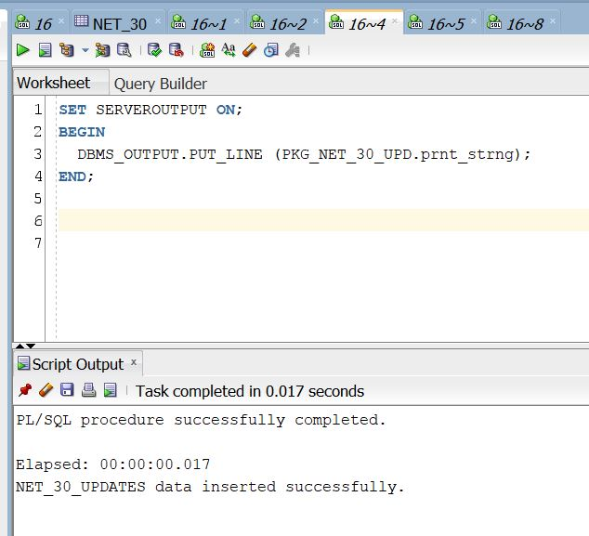
Demo: Step 4 | Call Function & Output String

Slide 60
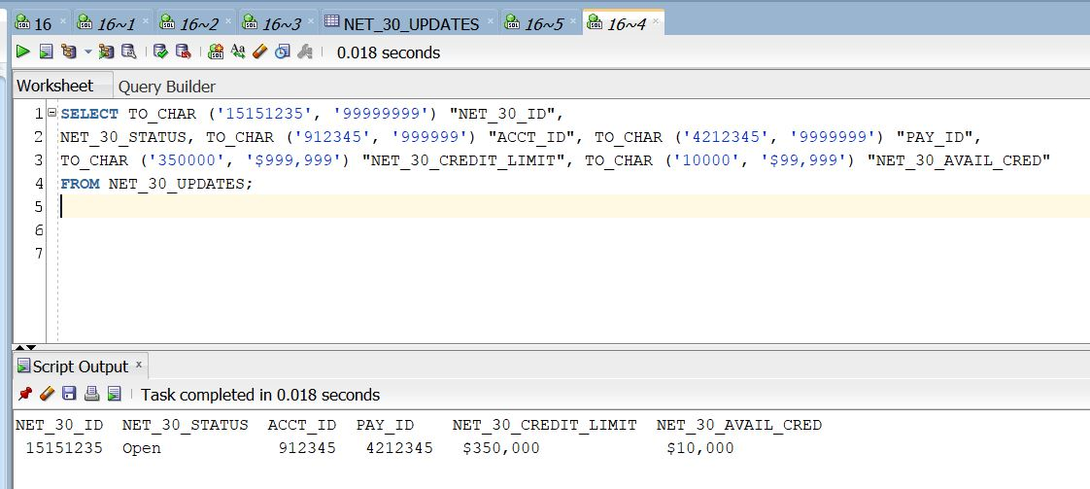
Demo: Step 5 | View Net_30_Updates Table Data

Slide 61
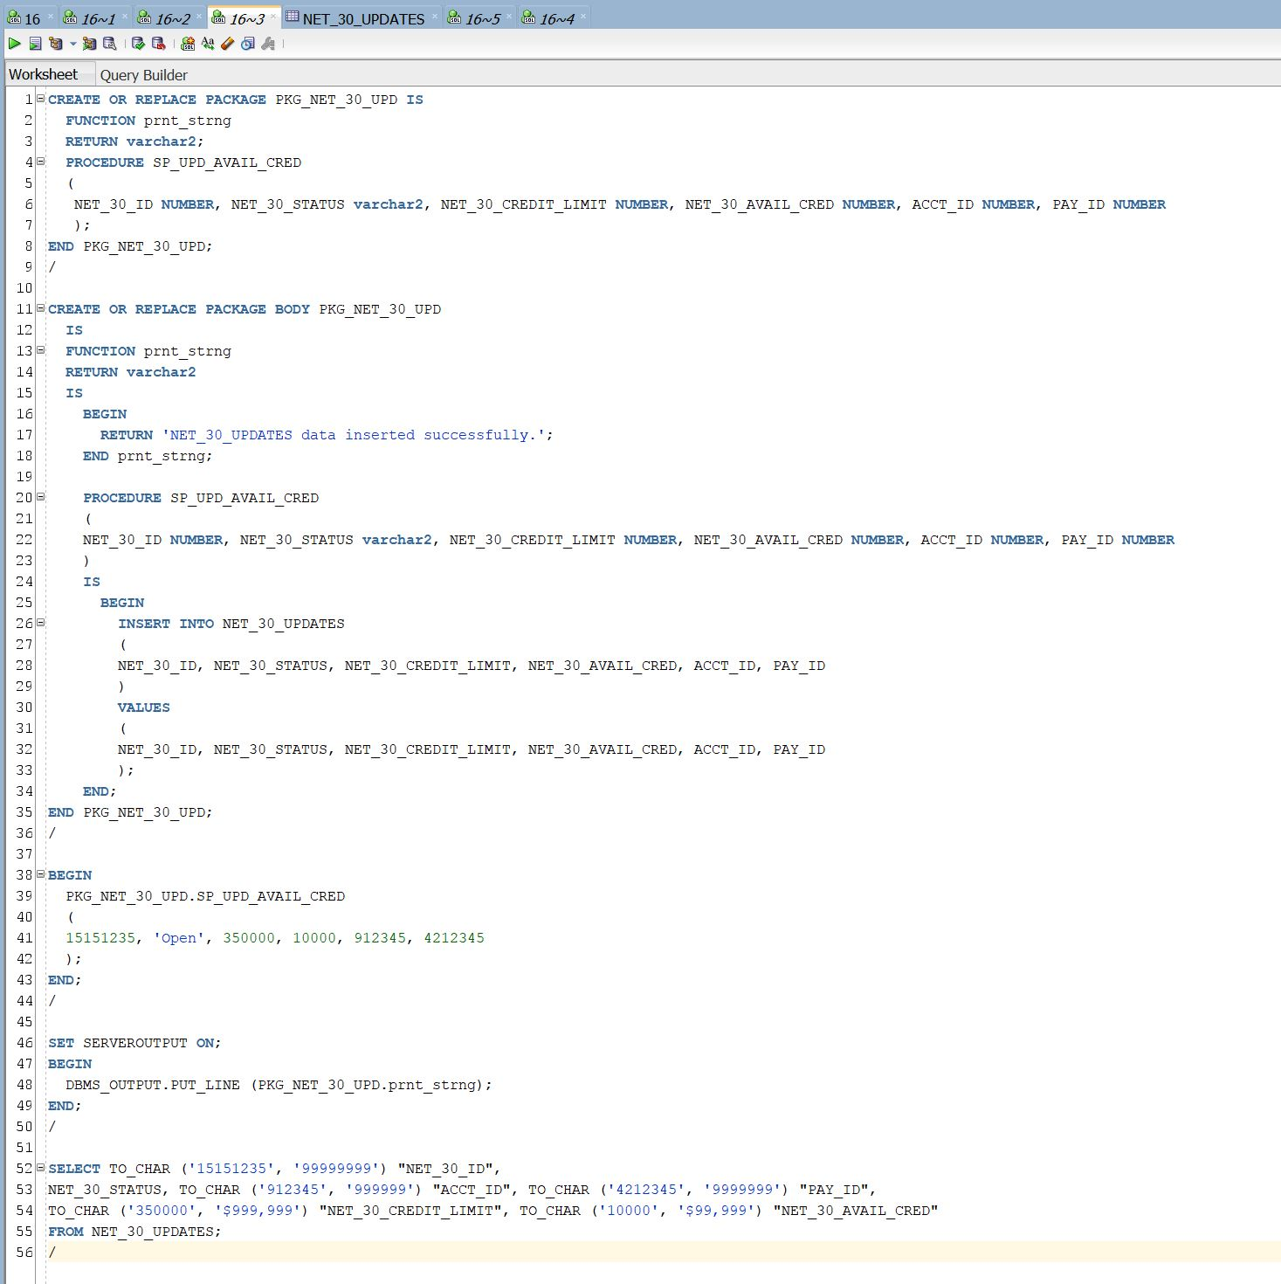
Demo: Full Package Configuration

Slide 62
Conclusion
Corporate Database Limitations
Database Design, E-commerce & Customer Access
Package Management (Functions & Stored Procedures)
Entity Relationship Diagram Characteristics
Stored Procedures
DBMS_SCHEDULER | Update Script
Data Encryption
Takeaways
Thank You!

